Slide 1
Digital Image Processing Technologies & Applications
Image Segmentation

Slide 2
Contents
Today we will begin looking at automated image analysis by examining the thorny issue of image segmentation:
Thresholding
Region based segmentation
Morphological watersheds approach

Slide 3
Thresholding
Thresholding is usually the first step in any segmentation approach
We have talked about simple single value thresholding already
Here we will look at:
Basic Global Thresholding
Basic Adaptive Thresholding
Minimisation Thresholding

Slide 4
Thresholding
Light objects in dark background.
To extract the objects:
— Select a T that separates the objects from the background.
— i.e. any (x, y) for which f(x, y)>T is an object point.

Slide 5
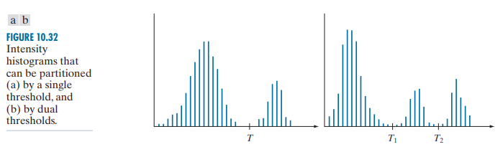
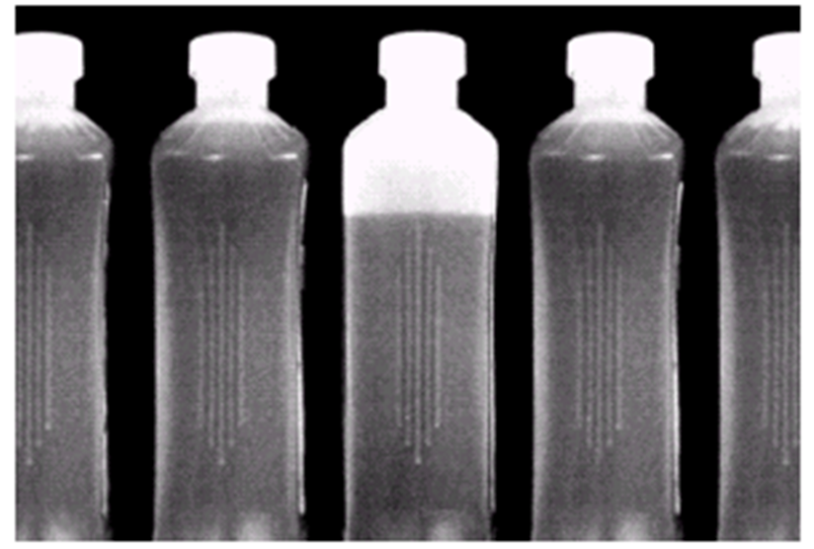
Thresholding
Background:
Object:
Background:
Object1:
Object2:
Notes:
瘦脸属不属于图像增强

Slide 6
Thresholding
More general form:
Where f(x, y) is the gray level of point (x, y), and p(x, y) denotes some local property of this point. For example: the average gray level of a neighborhood centered on (x, y)
T depends on:
Only f(x,y): only on gray-level values-> Global threshold;
Both f(x,y) and p(x,y)-> Local threshold;
On f(x,y), p(x,y), x, and y-> Adaptive threshold.

Slide 7
Thresholding
The success of intensity thresholding is related directly to the width and depth of the valley(s) separating the histogram modes. In turn, the key factors affecting the properties of the valley(s) are:
The separation between peaks，the further apart the peaks are, the better the chances of separating the modes;
The noise content in the image;
The relative sizes of objects and background;
The uniformity of the illumination source;
The uniformity of the reflectance properties of the image.

Slide 8
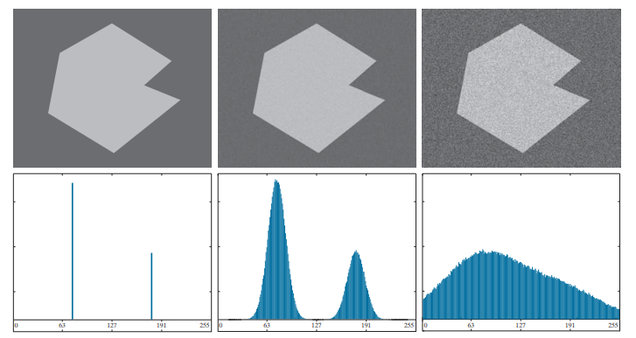
Thresholding
(a) Noiseless image. (b) Image with additive Gaussian noise of mean 0 and standard deviation of 10 intensity levels. (c) Image with additive Gaussian noise of mean 0 and standard deviation of 50 intensity levels. (d)~(f) Corresponding histograms.
Notes:
形态学去噪

Slide 9
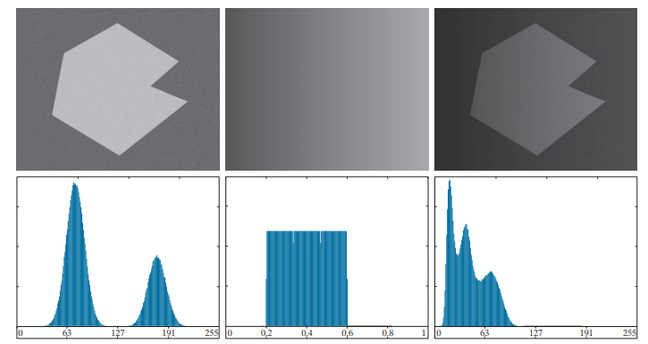
Thresholding
(a) Noisy image. (b) Intensity ramp in the range [0.2, 0.6]. (c) Product of (a) and (b). (d)~(f) Corresponding histograms.
Notes:
形态学去噪

Slide 10
Basic Global Thresholding
To partition the image histogram by using a single threshold T.
Then the image is scanned and labels are assigned.
This technique is successful in highly controlled environments. Or depends on how well the histogram can be partitioned.

Slide 11
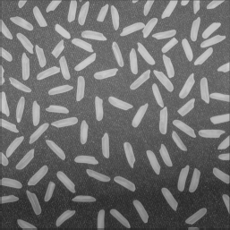
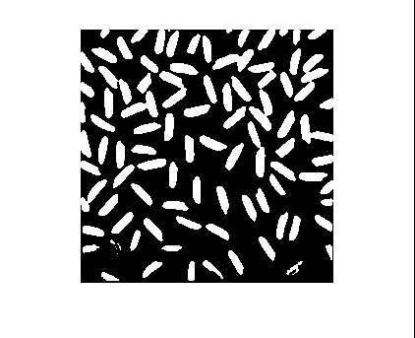
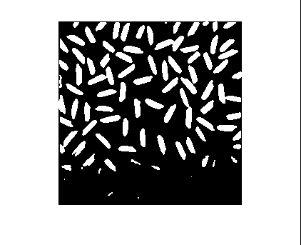
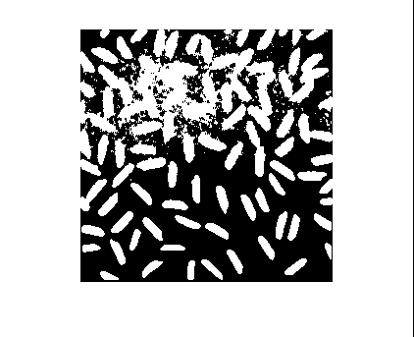
Basic Global Thresholding
Threshold2.m
Original Image
T=125
T=150
T=110

Slide 12
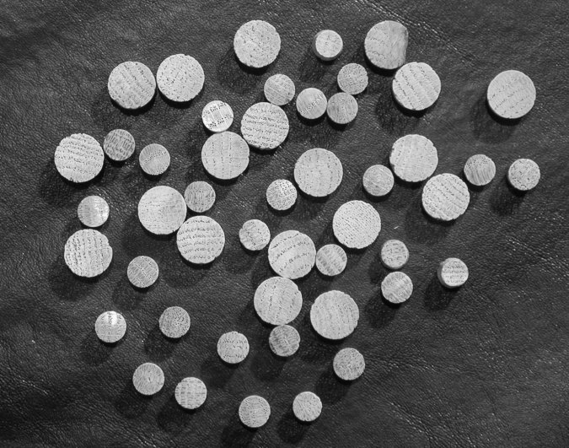
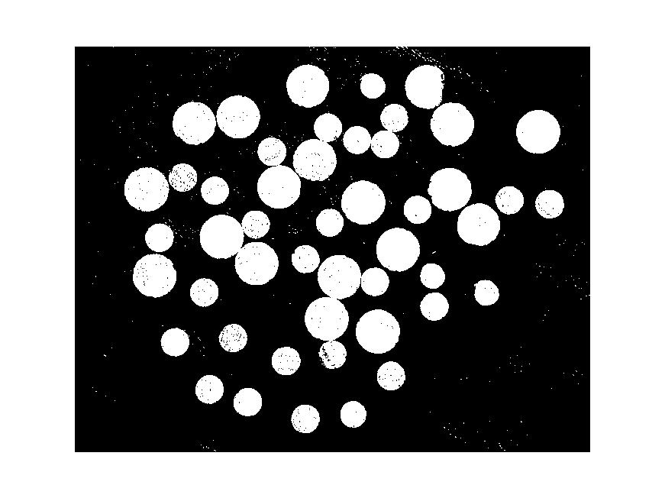
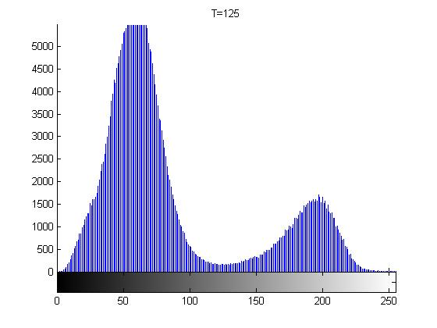

Basic Global Thresholding
T is gotten by observation
Notes:
形态学去噪

Slide 13
Basic Global Thresholding Algorithm
The basic global threshold, T, is calculated as follows:
Select an initial estimate for T (typically the average grey level in the image).
Segment the image using T to produce two groups of pixels: G₁ consisting of pixels with grey levels > T and G₂ consisting pixels with grey levels ≤ T.
Compute the average grey levels of pixels in G₁ to give μ₁ and G₂ to give μ_{2.}
Compute a new threshold value:
Repeat steps 2 – 4 until the difference in T in successive iterations is less than a predefined limit T_{0.}

Slide 14
Basic Global Thresholding Algorithm
Remarks:
When the background and object occupy comparable areas in the image, a good initial value for T is the average gray level of the image.
When objects are smaller than the background (or vice versa), then one group of pixels will dominate the histogram and the average gray level is not as good an initial choice.
A more appropriate initial value for T in cases such as this is the middle value.
Notes:
天气预报图像，微波成像

Slide 15
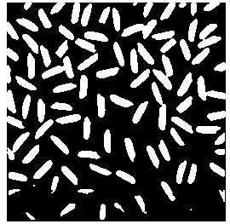
Basic Global Thresholding Algorithm
Original Image
T=125 By visual inspection
T=130.96 By basic global thresholding
Globalt.m

Slide 16
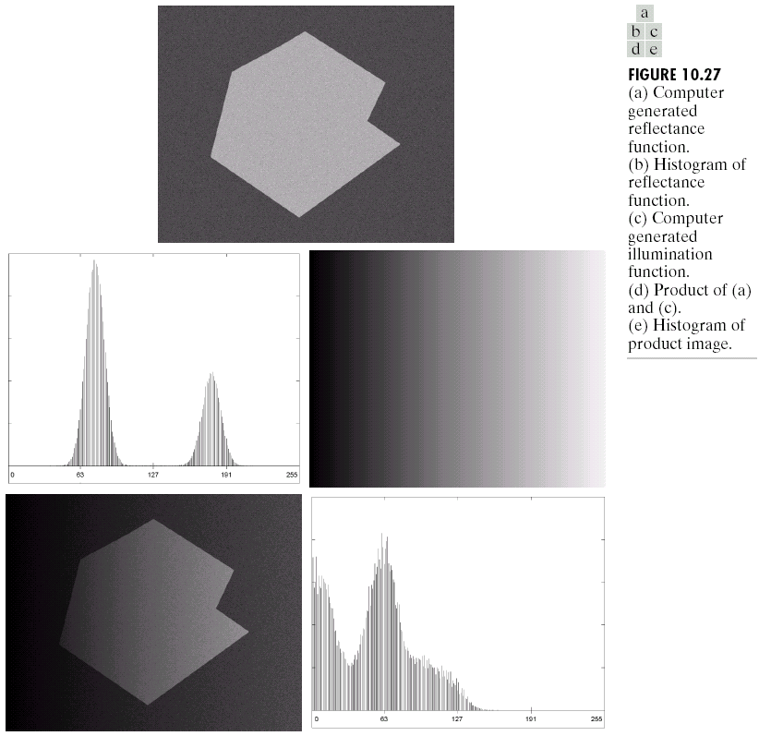
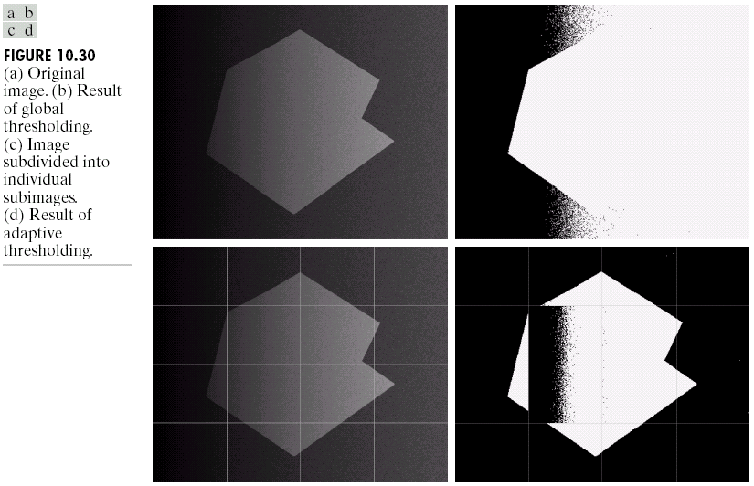
Single Value Thresholding and Illumination
Uneven illumination can really upset a single valued thresholding scheme.

Slide 17
Basic Adaptive Thresholding
An approach to handling situations in which single value thresholding will not work is to divide an image into sub images and threshold these individually.
Since the threshold for each pixel depends on its location within an image this technique is said to adaptive.

Slide 18
Basic Adaptive Thresholding Example
The image below shows an example of using adaptive thresholding with the image shown previously.
As can be seen success is mixed.
But, we can further subdivide the troublesome sub images for more success.
All the subimages that did not contain a boundary had variances of less than 75.
All subimages containing boundaries and had variances in excess of 100.
For each subimage, use basic global thresholding to segment it. Original T is middle gray level.
Notes:
aerial 航空的

Slide 19
Basic Adaptive Thresholding Example

Slide 20
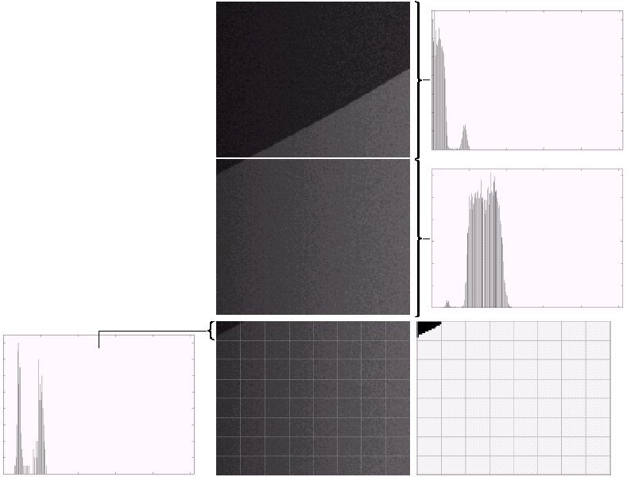
Basic Adaptive Thresholding Example (cont…)
Bimodal histogram
These images show the troublesome parts of the previous problem further subdivided.
After this sub division successful thresholding can be achieved.
Unimodal histogram

Slide 21
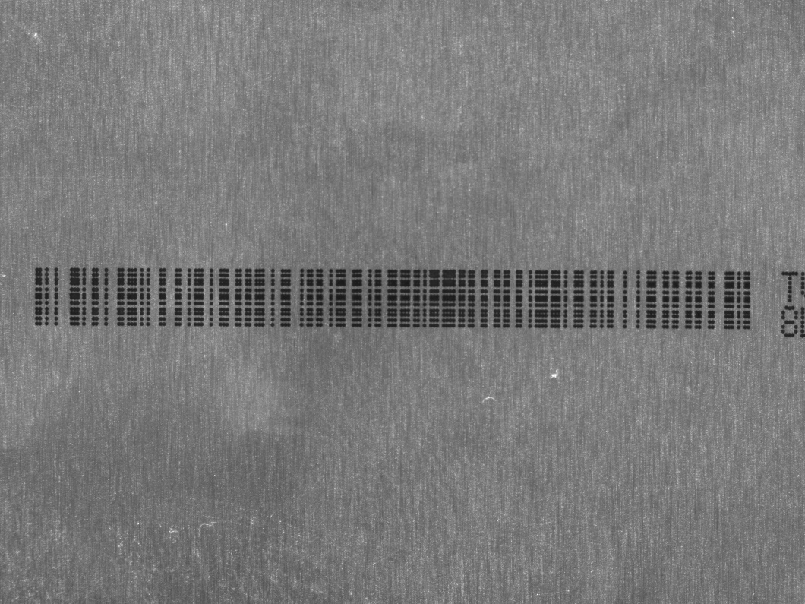
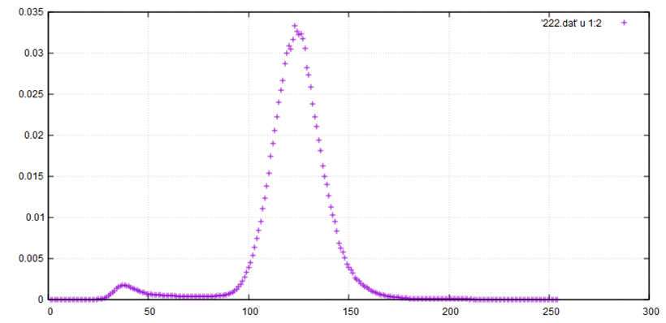
Otsu
Proposed by Nobuyuki Otsu (大津展之）
Optimization criterion of otsu: maximize the intra-class variance.（Otsu：取一个最优阈值把原图像分为前景与背景，两部分的类间方差越大，说明两部分差别越大，便能有效的分割图像。所以该算法最关键的是找到最优阈值。OTSU能够很好的分割图像中直方图波峰和波谷不明显的图像，但计算量比较大。）
Notes:
Otsu算法：取一个最优阈值把原图像分为前景色（A部分）与背景色（B部分），两部分的类间方差越大，说明两部分差别越大，便能有效的分割图像。所以该算法最关键的是找到最优阈值。OTSU能够很好的分割图像中直方图波峰和波谷不明显的图像，但计算量比较大。

Slide 22
Otsu
The mean of the image is M。
Now, there is a given threshold t, which can segment the image into two parts: Object and background:
The probability of group object is p_{o}(t)(前景像素点数占整幅图像的比例), mean is MO
The probability of group background is p_{b}(t) (背景像素点数占整幅图像的比例), mean is MB
The intra-class variance of Otsu：
Object: find a threshold that makes the maximum ICV.
Notes:
Otsu算法使用的是聚类的思想：
①把图像的灰度数按灰度级分成2个部分，使得两个部分之间的灰度值差异最大，每个部分之间的灰度差异最小；
②通过方差的计算来寻找一个合适的灰度级别来划分；
特点：
它是按图像的灰度特性,将图像分成背景和前景两部分；
因方差是灰度分布均匀性的一种度量,背景和前景之间的类间方差越大,说明构成图像的两部分的差别越大,当部分前景错分为背景或部分背景错分为前景都会导致两部分差别变小；
因此,使类间方差最大的分割意味着错分概率最小。

Slide 23
Otsu
Otsu算法使用的是聚类的思想：
把图像的灰度按灰度级分成2个部分，使得两个部分之间的灰度值差异最大，每个部分之间的灰度差异最小；
通过方差的计算来寻找一个合适的灰度级别来划分。
特点：
因方差是灰度分布均匀性的一种度量，背景和前景之间的类间方差越大，说明构成图像的两部分的差别越大，当部分前景错分为背景、或部分背景错分为前景都会导致两部分差别变小；
因此，使类间方差最大的分割意味着错分概率最小。

Slide 24
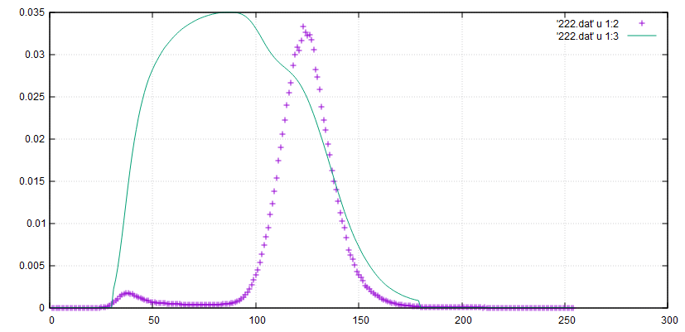
Otsu
Try all T to find the maximum ICV:

Slide 25

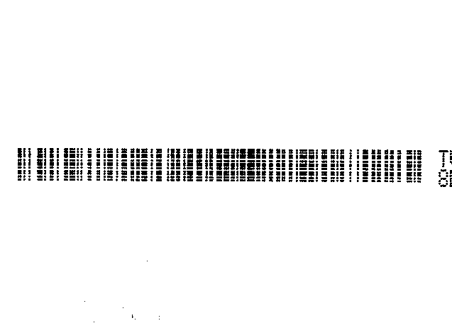
Otsu
Sometimes, when the sizes of Object and Background have big difference, it doesn’t work well.
We can consider to modify the criterion:
Notes:
比特平面分层

Slide 26
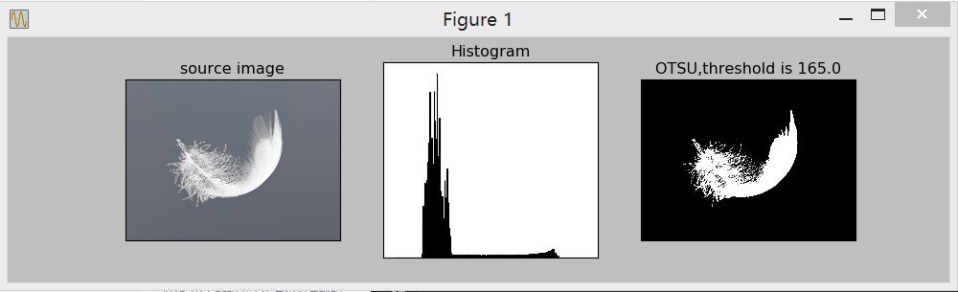
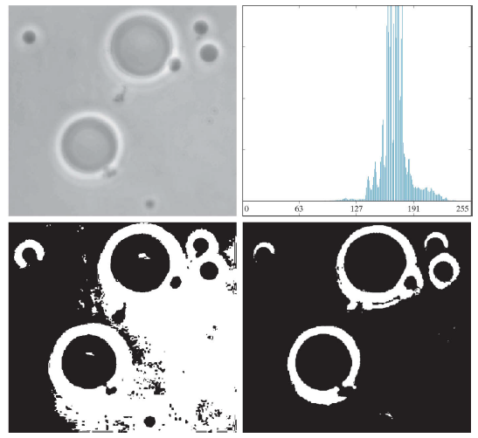
Otsu
对图像中仅有目标-背景类的图像，Otsu可以得到统计意义上的最优分割。
(a) Original image. (b) Histogram (high peaks were clipped to highlight details in the lower values). (c) Segmentation result using the basic global algorithm from Section 10.3 . (d) Result using Otsu’s method.
Notes:
(a) Original image. (b) Histogram (high peaks were clipped to highlight details in the lower values). (c) Segmentation result using the
basic global algorithm from Section 10.3 . (d) Result using Otsu’s method.

Slide 27
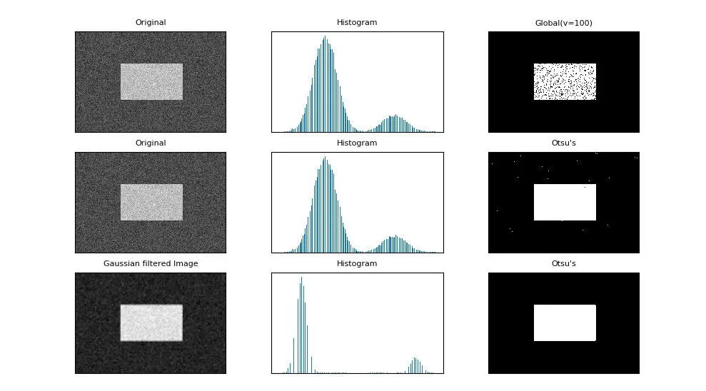
Otsu

Slide 28
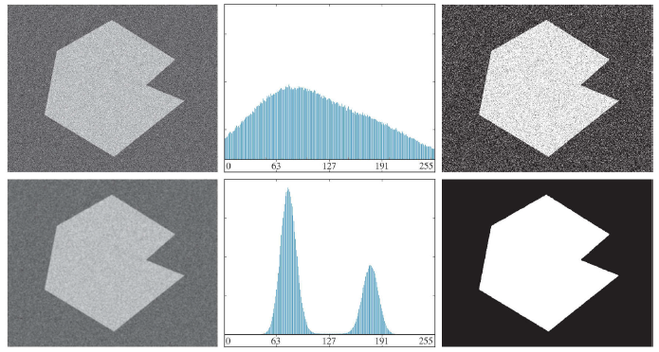
Otsu
Using Image Smoothing to Improve Global Thresholding
(a) Noisy image. (b) its histogram. (c) Obtained using Otsu’s method. (d) Smoothed using a averaging kernel. (e) its histogram. (f) Result of using Otsu’s method.
Notes:
x-x1-x2-x3-x4

Slide 29
Otsu
思考：当图像中有多个目标时，直接使用Otsu方法将失效，针对多目标的图像，往往需要多个阈值才能实现正确分割。
解决思路：先使用Otsu方法将图像分为背景和前景两类，然后再分别判断背景或前景中是否包含多个子目标（可通过子区域的方差进行判断）。
问题：比较耗时！

Slide 30
Region based segmentation
Points, lines, and edges: based on discontinuities in gray levels.
Thresholding: based on the distribution of pixel properties, such as gray level values and colors.
Region Growing: based on Similarity, finding the regions directly.

Slide 31
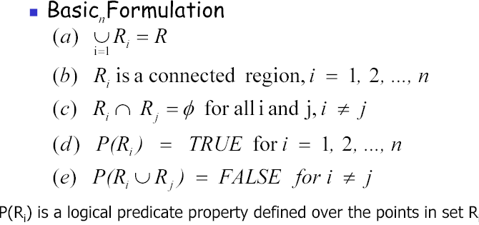
Region based segmentation
Region Based Segmentation: R is an image, segmentation is a process that partitions R into n sub-regions R₁, R₂, …, R_{n} such that:

Slide 32
Region Growing
Region Growing:
As name implies, region growing is a procedure that groups pixels or sub-regions into larger regions based on predefined criteria.
Select a group start (seed) points.
Grow the point based on a certain criteria.
The selection of criteria depends not only on the problem under consideration, but also on the type of image data available. For example:
Land-use satellite imagery: depend heavily on the use of color
Monochrome image: depends on set of descriptors based on gray levels and spatial properties (moments or texture).
Connectivity should be considered.
Another problem in region growing is the formulation of a stopping rule. Basically, growing a region should be stop when no more pixels satisfy the criteria in that region.

Slide 33
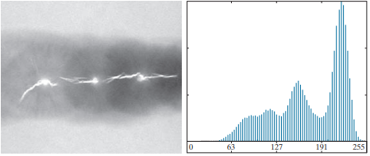
Region Growing
Region Growing:
–Determine seed points to maximum gray level.
–Growing criteria:
Gray level value difference (with respect to Seed Points) less than a threshold.
Each candidate pixel should be N8 of region.

Slide 34
Region Growing
Seed points: the points with 255 gray levels.
criteria:
the absolute gray-level difference between any pixel and the seed has to be less than 65
the pixel has to be 8-connected to at least one pixel in that region (if more the regions are merged)

Slide 35
Region Growing
生长过程：
根据种子点位置，找到该点的像素值
以种子点为中心，循环查找它 8 领域的像素，如果像素差在设定的某个阈值区间内则满足生长准则，将该点坐标压入堆栈，作为后面继续生长的点；
从堆栈结构中取出一个像素点，回到步骤 2；
重复步骤 1~3，直到图像中没有符合条件的点时，生长结束。
Remark: For the problems having multimodal histograms, it can best solved using region based approach.

Slide 36
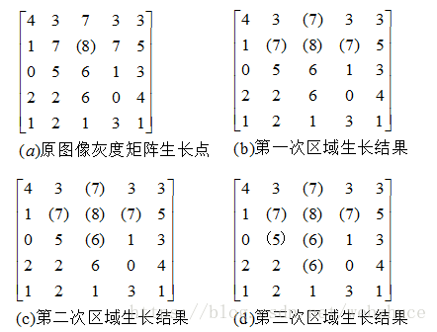
Region Growing
区域生长的实例：
图(a)为原始图像，数字表示像素的灰度。以灰度值为8的像素为初始的生长点，记为f(i,j)。在8邻域内，生长准则是待测点灰度值与生长点灰度值相差为1或0。
图(b)是第一次区域生长后，f(i-1,j)、f(i,j-1)、f(i,j+1)和生长点灰度值相差都是1，因而被合并。
图(c)是第二次生长后，f(i+1,j)被合并。
图(d)为第三次生长后，f(i+1,j-1)、f(i+2,j)被合并，至此，已经不存在满足生长准则的像素点，生长停止。

Slide 37
Region Splitting and Merging
Subdivide an image initially into a set of arbitrary, disjointed regions， and then merge and/or split the regions in an attempt to satisfy the conditions of region-oriented segmentation.
Splitting and Merging:
Define a criteria for each region to be a valid segment.
Split each region which is not satisfy the criteria.
Merge two neighbor region based on criteria.
Quadtree-based algorithm

Slide 38
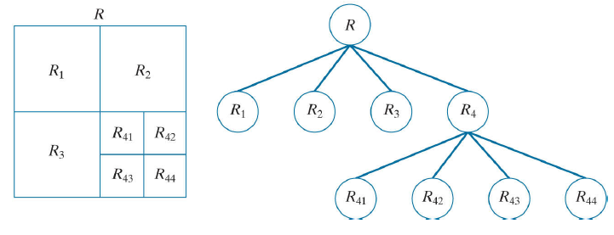
Region Splitting and Merging
Procedure:
Split into 4 disjointed quadrants, if any region R_{i} where P(R_{i}) = FALSE
Merge any adjacent regions R_{j} and R_{k} for which P(R_{j} ∪ R_{k}) = TRUE
Stop when no further splitting or merging is possible.
Notes:
If only splitting were used, the final partition likely would contain adjacent regions with identical properties.
This drawback may be remedied by allowing merging, as well as splitting.

Slide 39
Region Splitting and Merging
Criteria: If the gray level in the R_{i} are same, then P(R_{i}) = TRUE

Slide 40
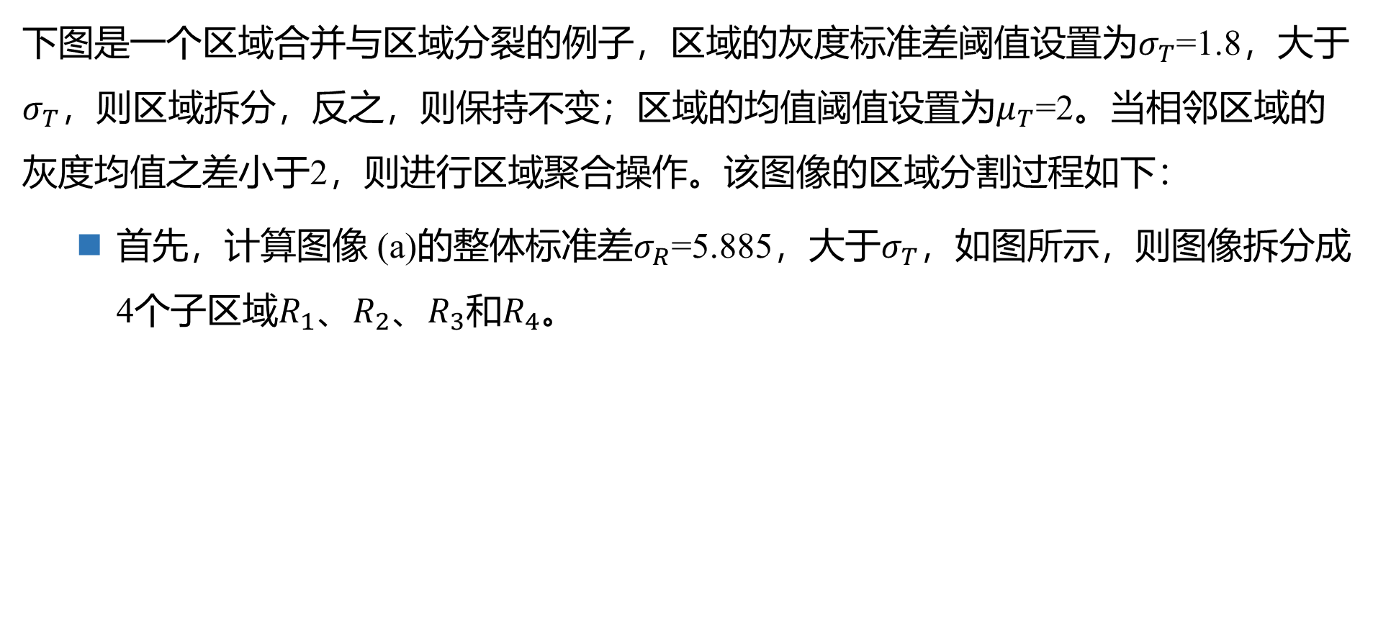
Region Splitting and Merging
下图是一个区域合并与区域分裂的例子，区域的灰度标准差阈值设置为$σ_{T}$=1.8，大于$σ_{T}$，则区域拆分，反之，则保持不变；区域的均值阈值设置为$μ_{T}$=2。当相邻区域的灰度均值之差小于2，则进行区域聚合操作。该图像的区域分割过程如下：
首先，计算图像 (a)的整体标准差$σ_{R}$=5.885，大于$σ_{T}$，如图所示，则图像拆分成4个子区域$R_{1}$、$R_{2}$、$R_{3}$和$R_{4}$。
(a)图像区域
(b)区域拆分I
(c)区域拆分II
(d) 区域聚合
区域拆分与区域聚合举例

Slide 41
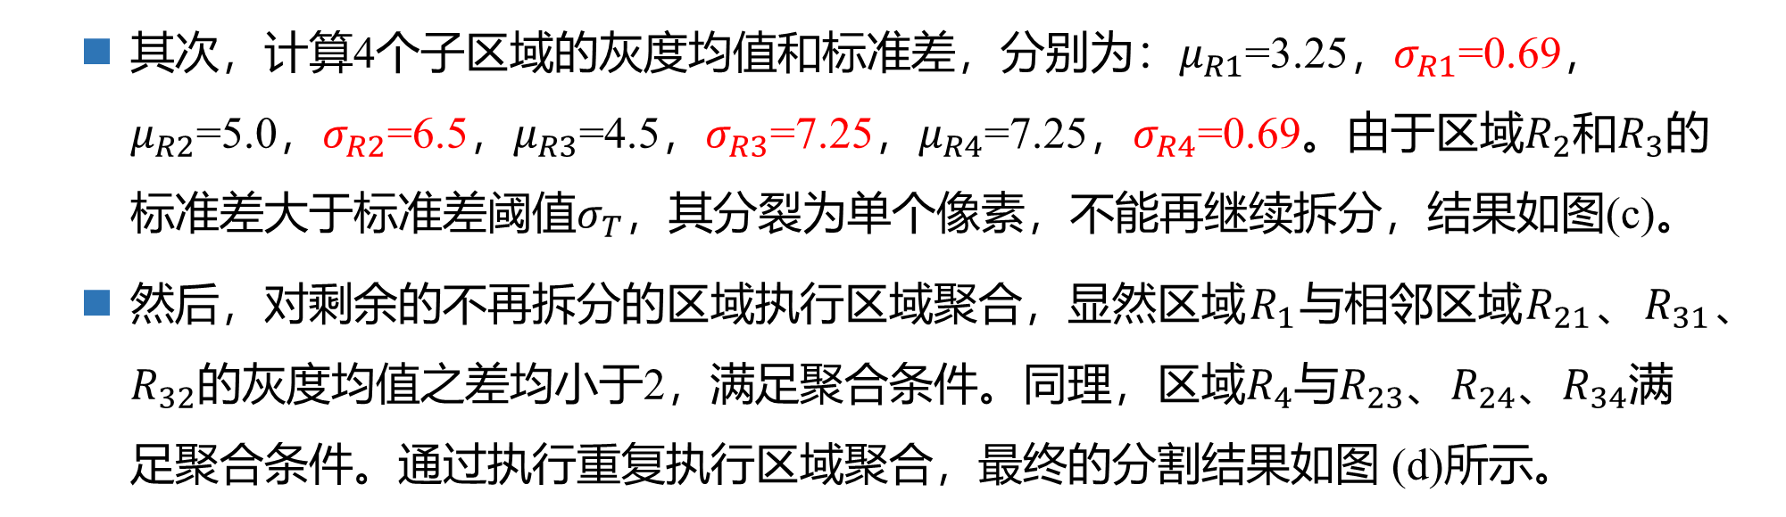
Region Splitting and Merging
其次，计算4个子区域的灰度均值和标准差，分别为：$μ_{R1}$=3.25，$σ_{R1}$=0.69，$μ_{R2}$=5.0，$σ_{R2}$=6.5，$μ_{R3}$=4.5，$σ_{R3}$=7.25，$μ_{R4}$=7.25，$σ_{R4}$=0.69。由于区域$R_{2}$和$R_{3}$的标准差大于标准差阈值$σ_{T}$，其分裂为单个像素，不能再继续拆分，结果如图(c)。
然后，对剩余的不再拆分的区域执行区域聚合，显然区域$R_{1}$与相邻区域$R_{21}$、$R_{31}$、$R_{32}$的灰度均值之差均小于2，满足聚合条件。同理，区域$R_{4}$与$R_{23}$、$R_{24}$、$R_{34}$满足聚合条件。通过执行重复执行区域聚合，最终的分割结果如图 (d)所示。
(a)图像区域
(b)区域拆分I
(c) 区域拆分II
(d) 区域聚合
区域拆分与区域聚合举例

Slide 42
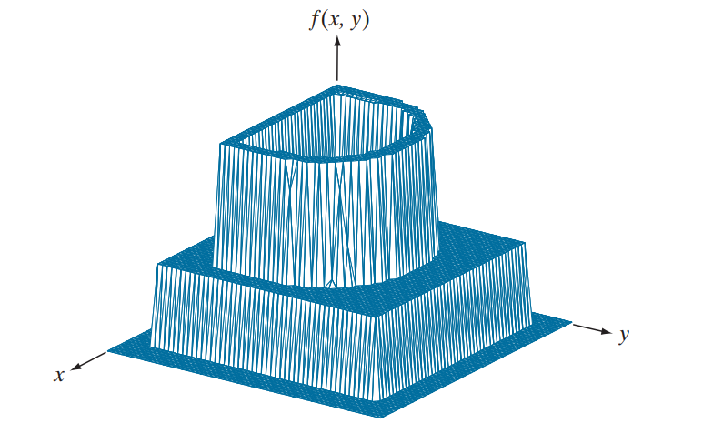
Morphological Watersheds
分水岭（Watershed）的概念是以三维的方式来显示图像为基础的：两个空间坐标对应xy平面，一个灰度级对应z平面，类似于表示海拔的地形图。

Slide 43
Morphological Watersheds
基本术语
在地形图上，有一些局部最小点，称为低洼，落在这些点的雨水不会流向它处。在一些区域，降落的雨水会沿着地形表面流向某一个低洼，流向同一个低洼的点构成了一个集（汇）水盆地。在一些点上，降落的雨水会等概率地流向不同的低洼，这些点组成的连线称为分水线。
在下面的一维图像中，有3个局部极小值，因此有3个低洼，流向同一个低洼的雨水沟成了集水盆，因此，相应地有3个集水盆地。分水岭将不同集水盆地分开，因此，有4个分水线。

Slide 44
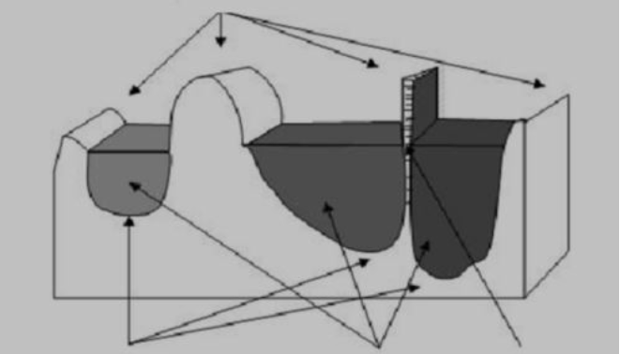
Morphological Watersheds
分水线
局部极小值点
汇水盆地
水坝

Slide 45
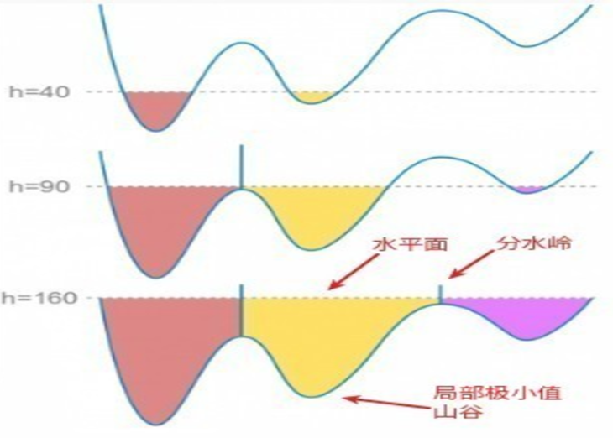
Morphological Watersheds
基于这些概念的分割算法的主要目标是找出分水线，其基本思想很简单：
假设在每个区域最小值的位置上打一个洞，并且让水以均匀的上升速率从洞中涌出，从低到高淹没整个地形。
当处于不同的汇水盆地里的水将要聚合在一起的时候，修建大坝以阻止聚合。
这个过程不断延续直至达到水位的最大值（对应于图像中灰度级的最大值），这些大坝的边界即对应于分水岭的分割线。
分水岭比较经典的计算方法是L．Vincent于1991年在PAMI上提出的。

Slide 46
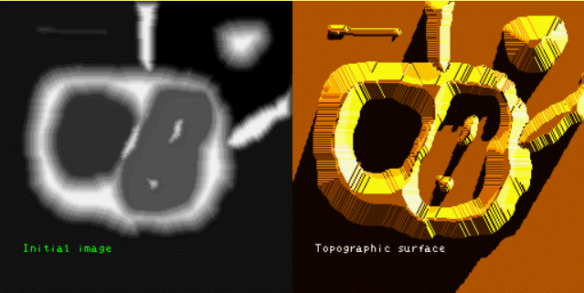
Morphological Watersheds
左侧是输入灰度图像、右侧是其对应的地形图，地形图中山的高度与输入图像中的灰度值成正比。
为了防止水溢出图像边界，我们假设整幅图像的边缘被高于最高山峰的水坝包围。

Slide 47
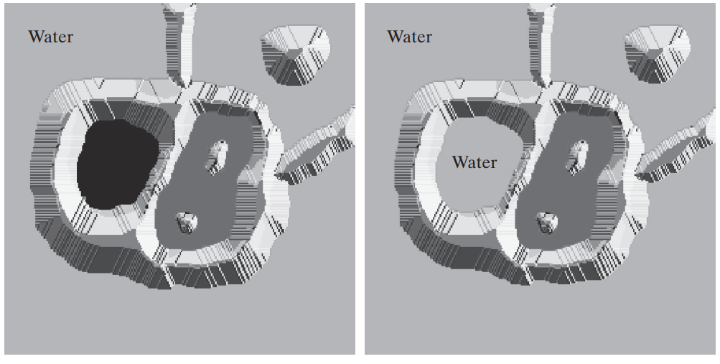
Morphological Watersheds
被水淹没的第一阶段，这里水用浅灰色表示，覆盖了图中对应的深色区域。

Slide 48

Morphological Watersheds
当水即将从一个汇水盆地溢出到另一个汇水盆地的时候，在两者之间构筑一个短“坝”来阻止汇合，当水位不断上升，需要构筑的“坝”就不断加长。

Slide 49
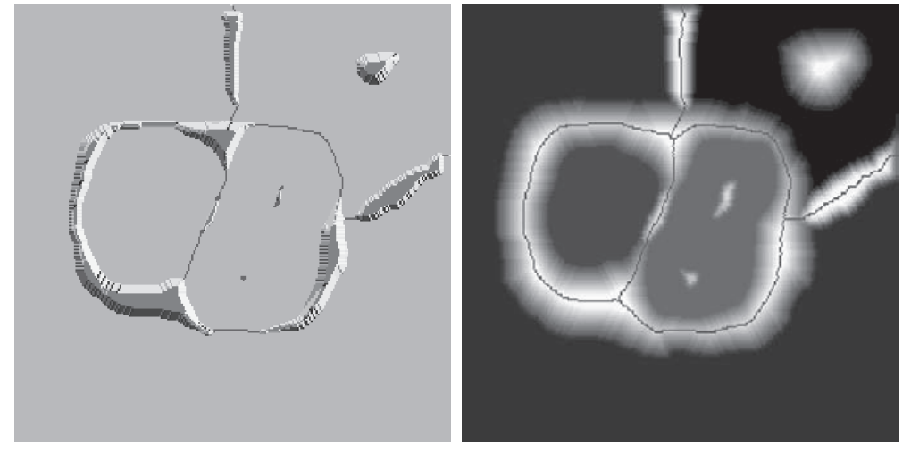
Morphological Watersheds
这个过程不断延续只到达到水位的最大值（对应于图像中灰度级的最大值），这些大坝的边界对应于分水岭的分割线。

Slide 50
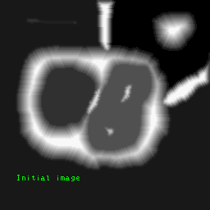
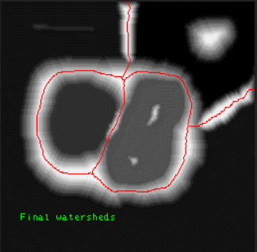
Morphological Watersheds
The process of building dams.
这种方法的一个重要性质就是分水线组成一条连通路径，由此给出了区域之间的连续边界。

Slide 51
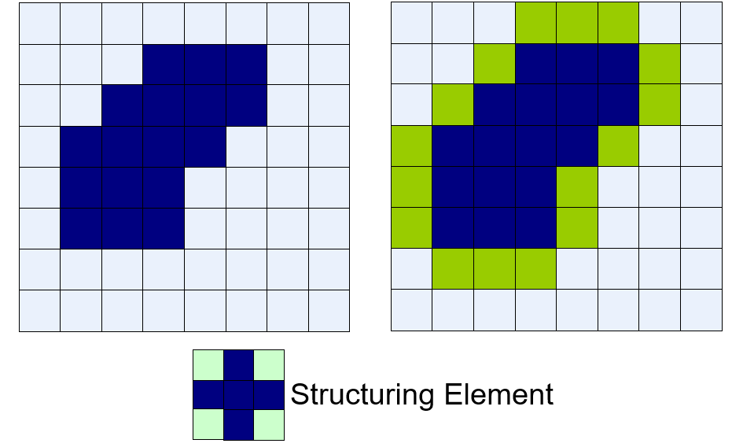
Morphological Watersheds
分水岭分割算法的主要应用是从背景中分割出灰度级较为一致的区域，那些在灰度级上变化较小的区域其梯度也较小。
因此，实际上我们经常将分水岭算法和图像梯度联系起来。
汇水盆地的局部最小值就可以与关注对象的小的梯度值联系起来了。
水坝的构造以二值图像为基础。
构造水坝最简单的方法是使用形态学膨胀。

Slide 52
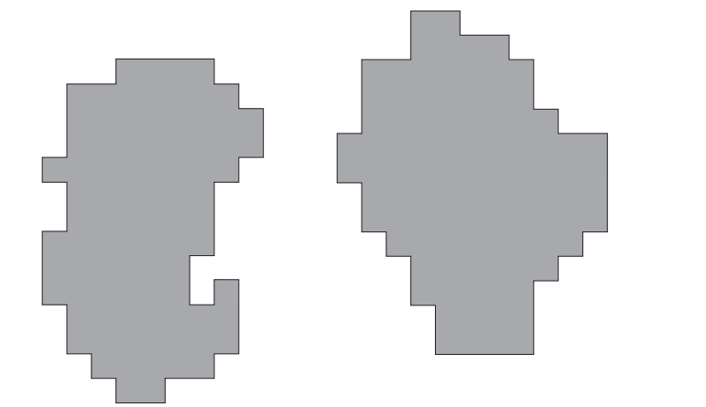
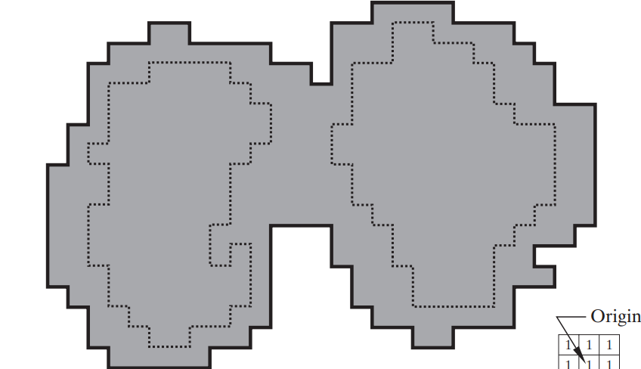
Dam Construction
B）显示了下一步淹没（第n步）的情况。水已经从一个盆地溢出到了另外一个盆地，所以必须构造水坝进行阻止。
A）显示了两个汇水盆地的部分区域在淹没步骤的第n-1步时的图像。

Slide 53
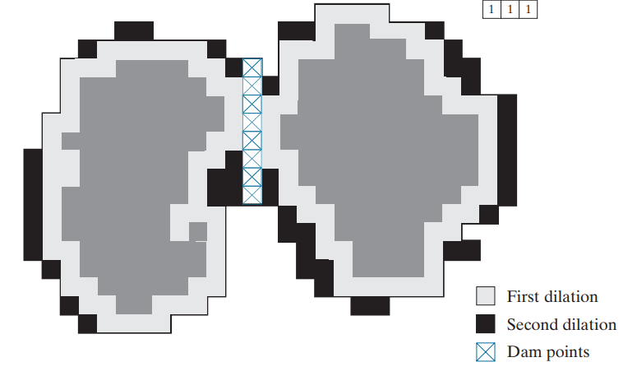
Dam Construction
上图中，第一次膨胀（浅灰色）扩展了每个原始连通分量的边界。
在第二次膨胀中（图中显示为黑色），被标记成右图中叉线显示的单像素宽路径，就是我们希望的分割水坝。
在水坝的位置上设置为一个大于图像灰度级的值，可以防止当水位升高时漫过构建的水坝。

Slide 54
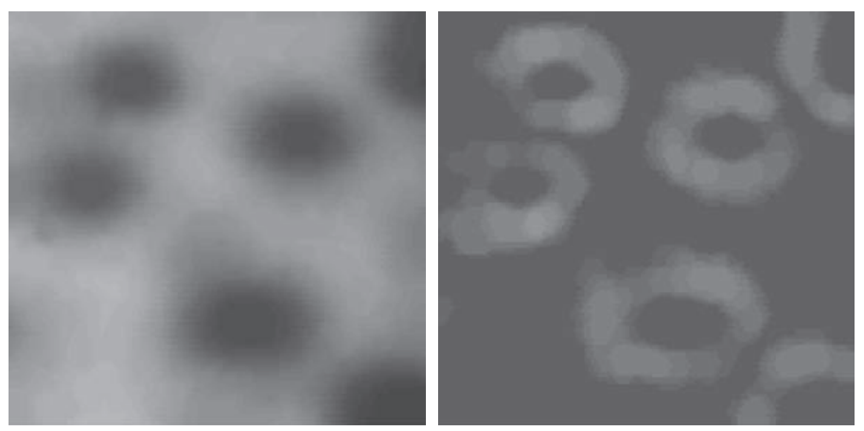
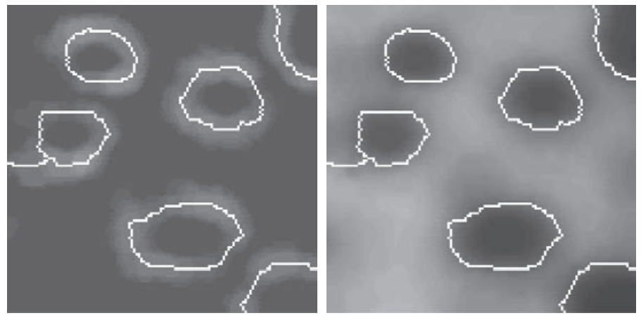
Watershed Segmentation Algorithm
a) Original Image
b)Image Gradient
c) Watershed lines superimposed on the gradient image.
d) Watershed lines superimposed on the original image.

Slide 55
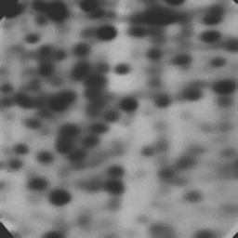
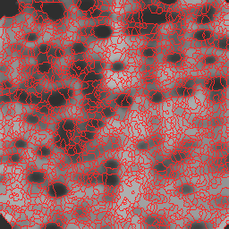
Watershed Segmentation Algorithm
用上面的算法对图像进行分水岭运算，通常会因为噪声或梯度的局部不规则性导致过度分割（over-segmented），即图像被分割得太细，这是由于图像中有非常多的局部极小值点，每个点都会自成一个小区域。
Notes:
https://people.cmm.minesparis.psl.eu/users/beucher/wtshed.html

Slide 56
Watershed Segmentation Algorithm
解决方法：
对图像进行高斯平滑操作，抹除很多小的最小值，这些小分区就会合并。
不从最小值开始增长，可以将相对较高的灰度值像素作为起始点（需要用户手动标记），从标记处开始进行淹没，则很多小区域都会被合并为一个区域，这被称为基于图像标记(mark)的分水岭算法。
与感兴趣目标相关的标记称为内部标记，与背景相关的称为外部标记。
例如，假设内部标记：1）被更高“海拔”的点包围的区域；2）区域中形成连通分量的那些点；3）连通分量中具有相近灰度级的点。
Notes:
https://people.cmm.minesparis.psl.eu/users/beucher/wtshed.html

Slide 57
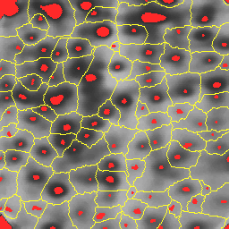
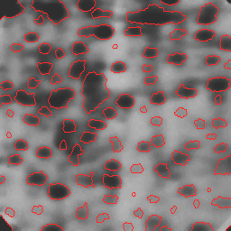
Watershed Segmentation Algorithm
对前面的图像，先进行平滑，抑制噪声的影响。
采用内部标记的方式在原图中对感兴趣的目标进行标记（红色区域），对标记的图像用分水岭算法得到左图结果。
对左图分割的每个区域（仅包含对象和背景）再一次应用分水岭分割算法，即可得到右侧分割结果。
Notes:
https://people.cmm.minesparis.psl.eu/users/beucher/wtshed.html

Slide 58
Watershed Segmentation Algorithm
Notes:
https://people.cmm.minesparis.psl.eu/users/beucher/wtshed.html

Slide 59
Summary
There are many other segmentation technologies:
Susan Operators
Snake modal
Global Hough Transform
….

